Slide 1
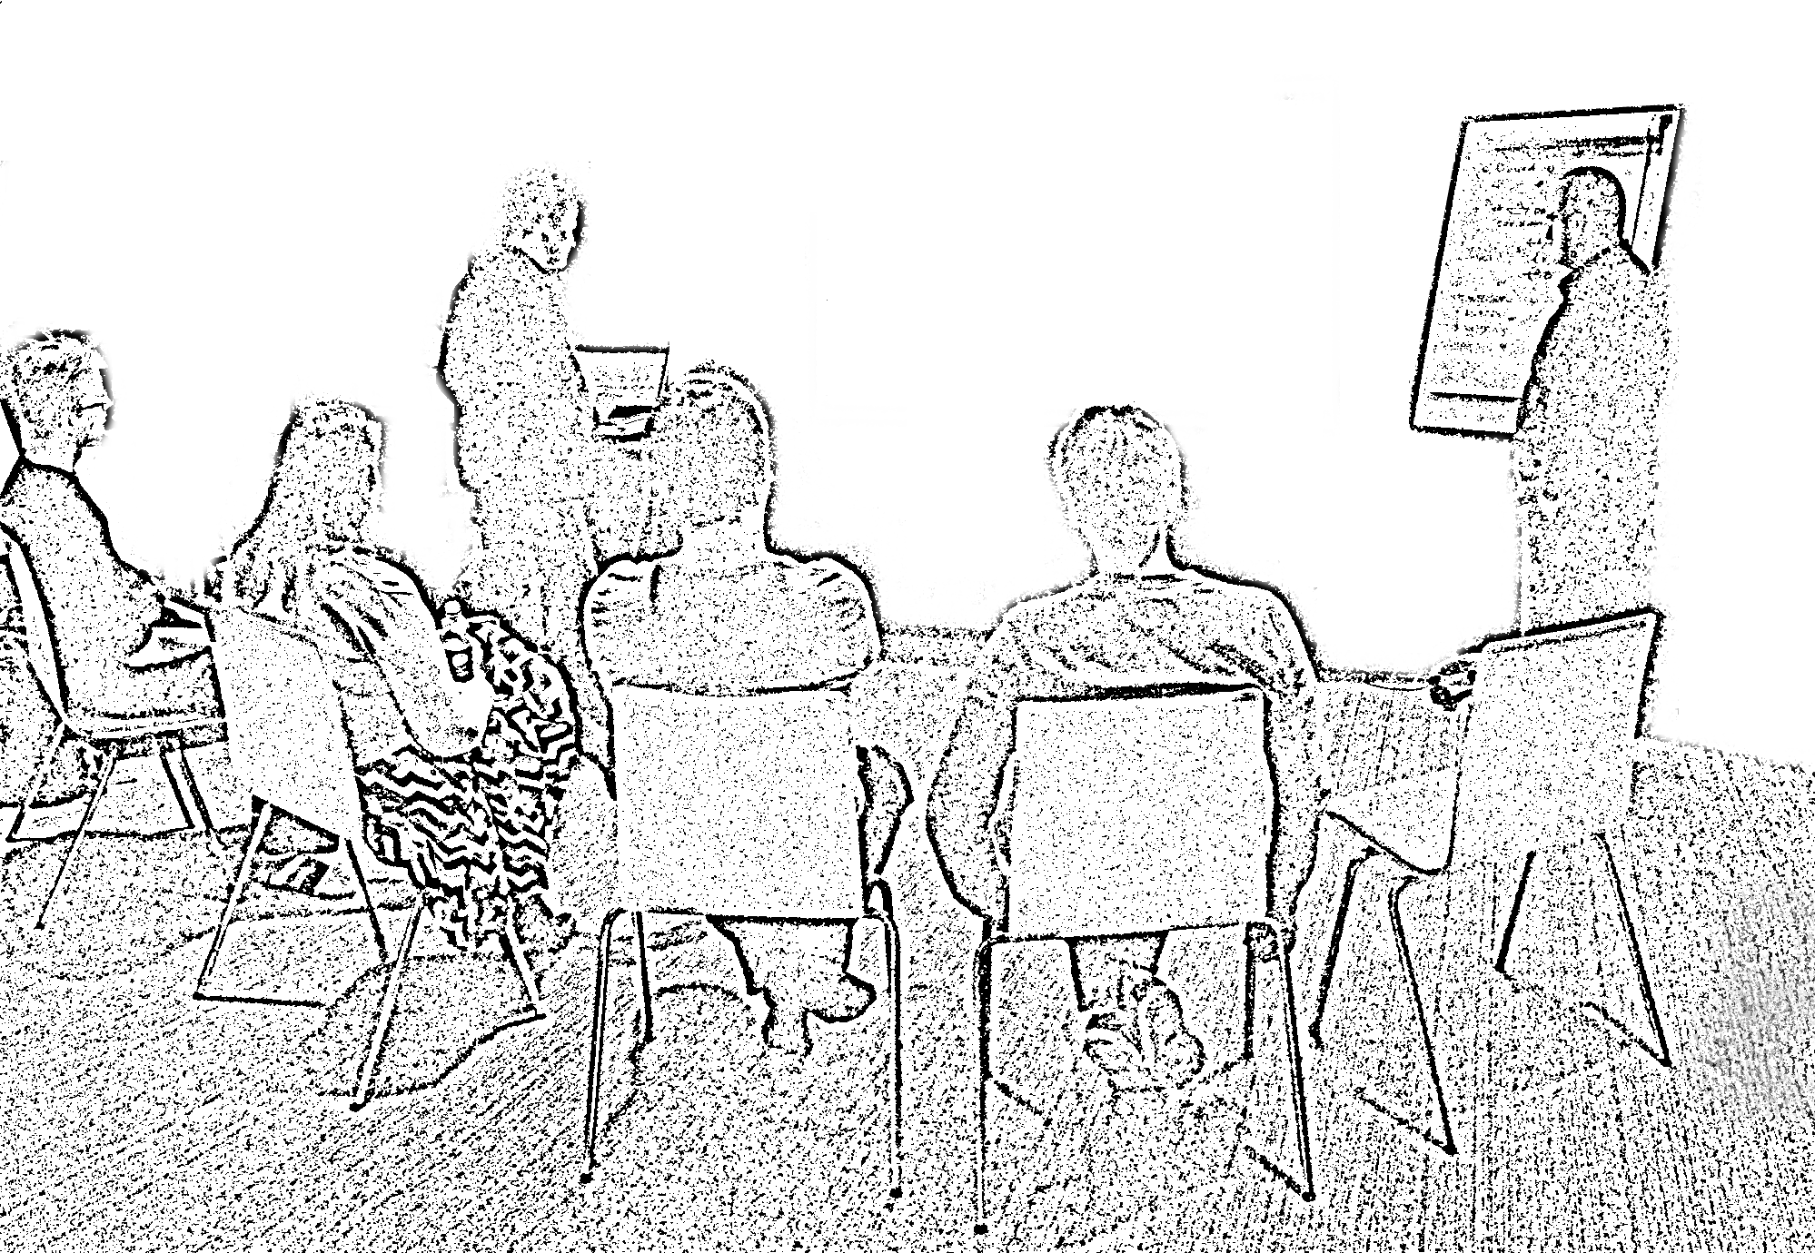
The
Mob Programming
Guidebook
Llewellyn Falco & Maaret Pyhäjärvi

Slide 2


The
Mob Programming
Guidebook
Llewellyn Falco & Maaret Pyhäjärvi

